Slide 1
Chapter 1 Objectives
The CCNA Topics Covered in this chapter include:
  TCP-IP Stack
  TCP header
  UDP header
  TCP connection establishment
  Differences between TCP & UDP
  IP header

Slide 2
TCP/IP Protocol Stack
Application
Presentation
Session
Application
Transport
Transport
Network
Internet
Data-Link
Data-Link
Physical
Physical

Slide 3
Application Layer overview
File Transfer
- TFTP*
- FTP*
- NFS
E-Mail
- SMTP
Remote Login
- Telnet*
- rlogin*
Network Management
- SNMP*
Name Management
- DNS*
Application
Transport
Internet
Data-Link
*Used by the Router
Physical

Slide 4
Transport Layer overview
Transmission Control
Protocol (TCP)
User Datagram
Protocol (UDP)
Connection-Oriented
Connectionless
Application
Transport
Internet
Data-Link
Physical

Slide 5
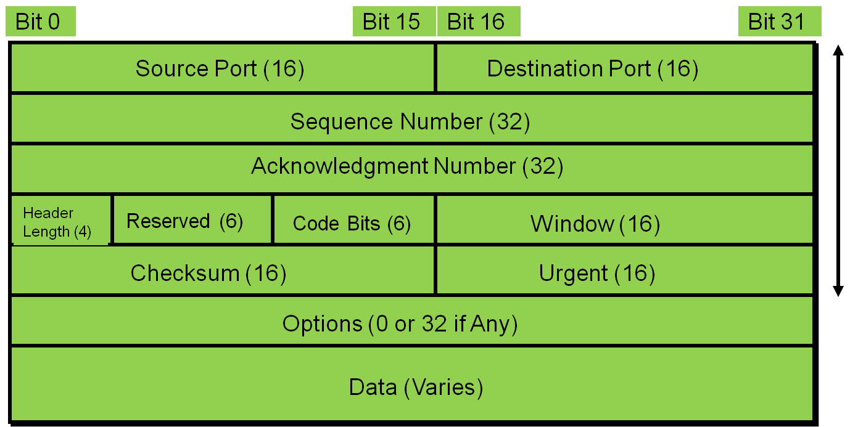
TCP Segment format
20 Bytes

Slide 6
Port Numbers
T
E
L
N
E
T
F
T
P
S
M
T
P
D
N
S
T
F
T
P
S
N
M
P
R
I
P
Application Layer
21
23
25
53
69
161
520
Port Numbers
Transport Layer
TCP
UDP
Key Protocols and Port Numbers
TCP UDP
Telnet 23 SNMP 161
SMTP 25 TFTP 69
HTTP 80 DNS 53
FTP 21
DNS 53
HTTPS 443

Slide 7
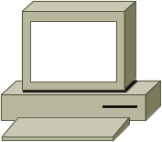
TCP Port Numbers
Source
Port
Destination
Port
…
Telnet Z
Host A
Host Z
SP
DP
Destination port = 23.
Send packet to my
Telnet
application.
1025
23
…

Slide 8
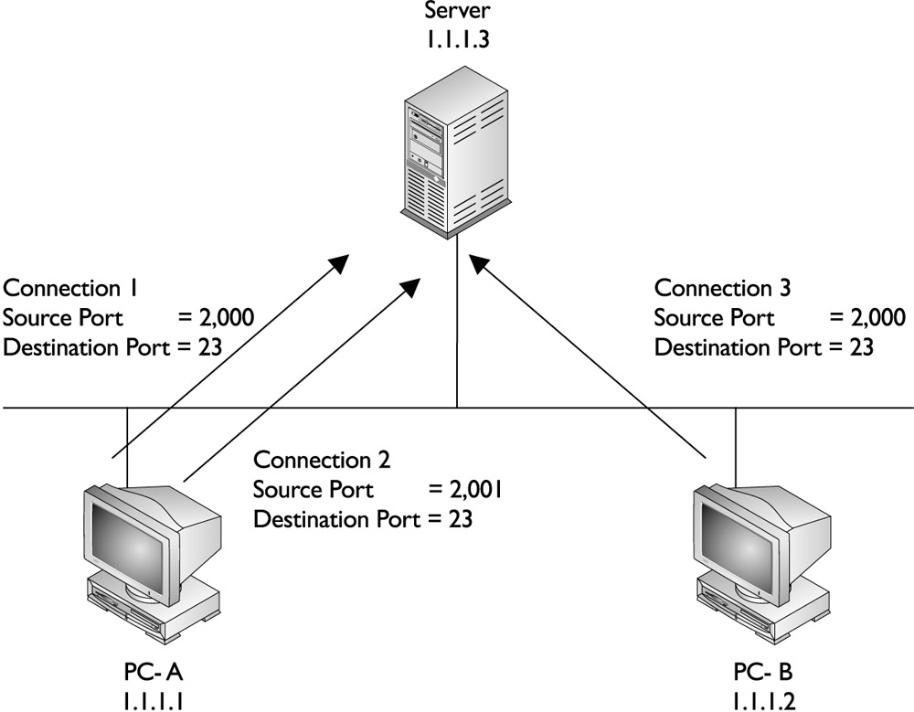
TCP Port Numbers

Slide 9
TCP Connection Establishment
Three-way handshake
Host A
Host B
1
Send SYN
(seq = 100 ctl = SYN)
SYN Received
2
SYN Received
Send SYN, ACK
(seq = 300 ack = 101 ctl = syn,ack)
3
Established
(seq = 101 ack = 301 ctl = ack)

Slide 10
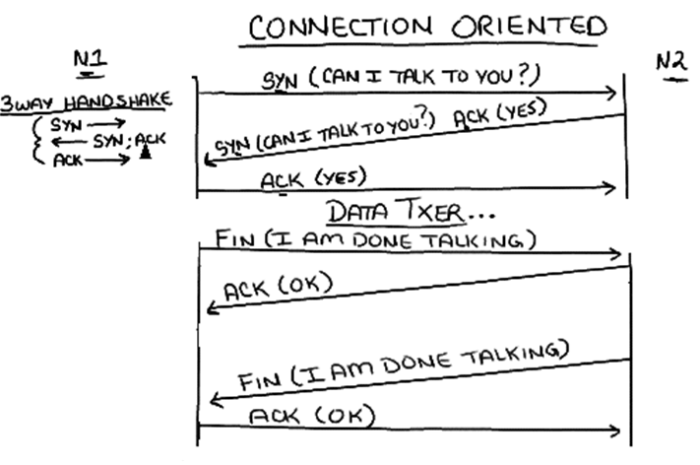
Opening and closing TCP connection

Slide 11
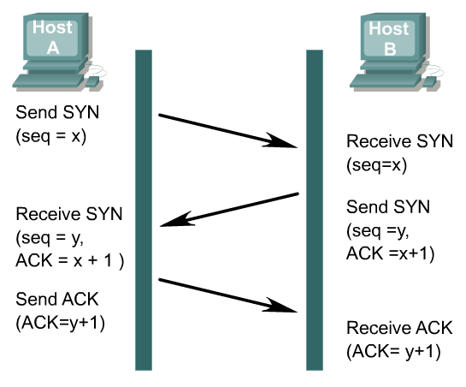
Packet 1: source: 130.57.20.10 dest.:130.57.20.1
TCP: ----- TCP header -----
TCP: Source port = 1026
TCP: Destination port = 524
TCP: Initial sequence number = 12952
TCP: Next expected Seq number= 12953
TCP: .... ..1. = SYN
TCP: Window = 8192
TCP: Checksum = 1303 (correct)
TCP: Maximum segment size = 1460 (TCP Option)
Packet 2: source: 130.57.20.1 dest: 130.57.20.10
TCP: ----- TCP header -----
TCP: Source port = 524
TCP: Destination port = 1026
TCP: Initial sequence number = 2744080
TCP: Next expected Seq number= 2744081
TCP: Acknowledgment number = 12953
TCP: .... ..1. = SYN
TCP: Window = 32768
TCP: Checksum = D3B7 (correct)
TCP: Maximum segment size = 1460 (TCP Option)
Packet 3: source: 130.57.20.10 dest: 130.57.20.1
TCP: ----- TCP header -----
TCP: Source port = 1026
TCP: Destination port = 524
TCP: Sequence number = 12953
TCP: Next expected Seq number= 12953
TCP: Acknowledgment number = 2744081
TCP: ...1 .... = Acknowledgment
TCP: Window = 8760
TCP: Checksum = 493D (correct)
TCP: No TCP options
Only part of the TCP headers are displayed.

Slide 12
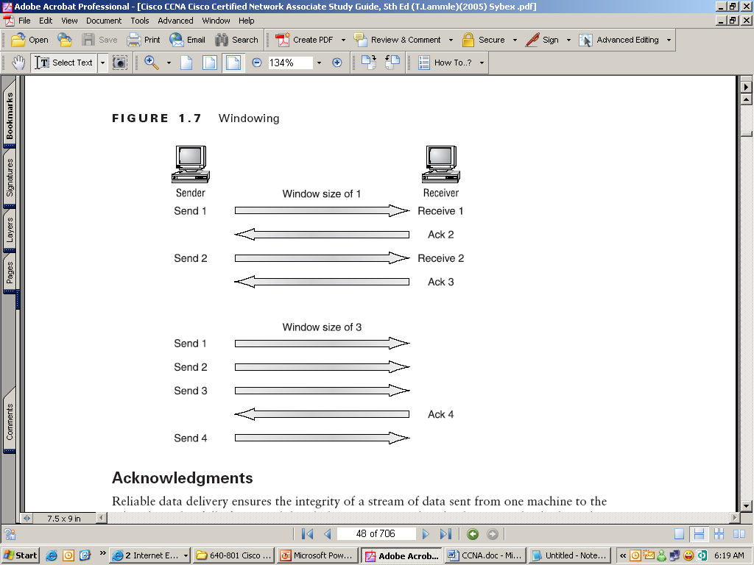
Windowing
Windowing in networking means the quantity of data segments which is measured in bytes that a machine can transmit/send on the network without receiving an acknowledgement
When you’ve configured a window size of 1, the sending machine waits for an acknowledgment for each data segment it transmits before transmitting another.
If you’ve configured a window size of 3, it’s allowed to transmit three data segments before an acknowledgment is received.

Slide 13
UDP
User Datagram Protocol (UDP) is the connectionless transport protocol in the TCP/IP protocol stack.
UDP is a simple protocol that exchanges datagrams, without acknowledgments or guaranteed delivery. Error processing and retransmission must be handled by higher layer protocols.
UDP is designed for applications that do not need to put sequences of segments together.
The protocols that use UDP include:
TFTP (Trivial File Transfer Protocol)
SNMP (Simple Network Management Protocol)
DHCP (Dynamic Host Control Protocol)
DNS (Domain Name System)

Slide 14
UDP Segment format
Bit 0
1
Bit 15
Bit 16
Bit 31
Source Port (16)
Destination Port (16)
8 Bytes
Length (16)
Checksum (16)
Data (if Any)
No sequence or acknowledgment fields

Slide 15
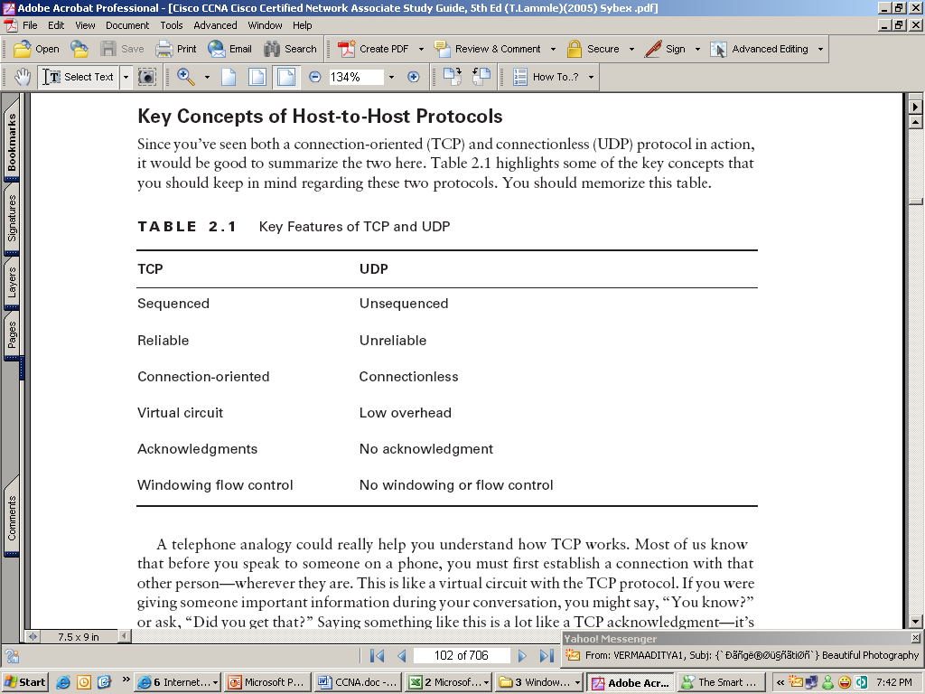
TCP vs UDP

Slide 16
Internet Layer Overview
Internet Protocol (IP)
Internet Control Message
Protocol (ICMP)
Address Resolution
Protocol (ARP)
Reverse Address
Resolution Protocol (RARP)
Application
Transport
Internet
Data-Link
Physical

Slide 17
IP (Internet Protocol) Header
Bit 0
Bit 15
Bit 16
Bit 31
Version
(4)
Header
Length (4)
Priority &Type
of Service (8)
Total Length (16)
Flags
(3)
Identification (16)
Fragment Offset (13)
Time-to-Live (8)
Protocol (8)
Header Checksum (16)
20 Bytes
Source IP Address (32)
Destination IP Address (32)
Options (0 or 32 if Any)
Data (Varies if Any)

Slide 18
Protocol Field in IP Header
Transport Layer
TCP
UDP
6
17
Protocol
Numbers
Internet Layer
IP

